Slide 1

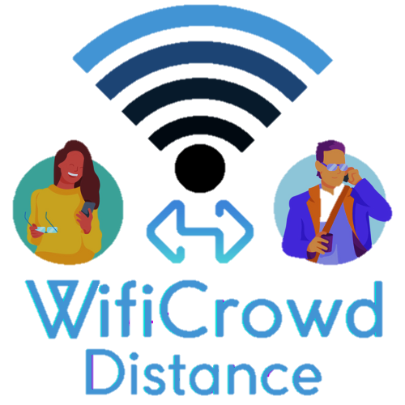
SOCIAL DISTANCE CONTROL SYSTEM THROUGH WIFI-BASED POSITIONING TECHNIQUES.
MEMBERS -Kevin BLUM LUNA -MARINA TOALA ZURITA

Slide 2

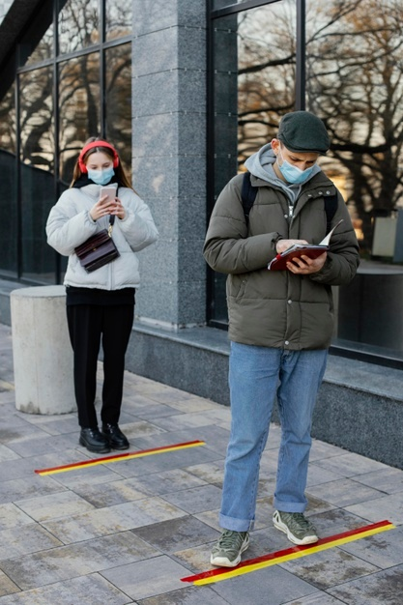
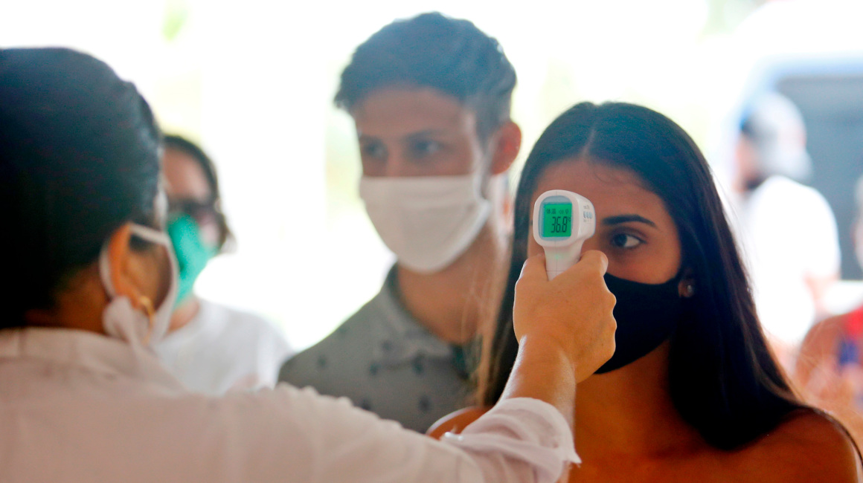
Imagen real

Slide 3
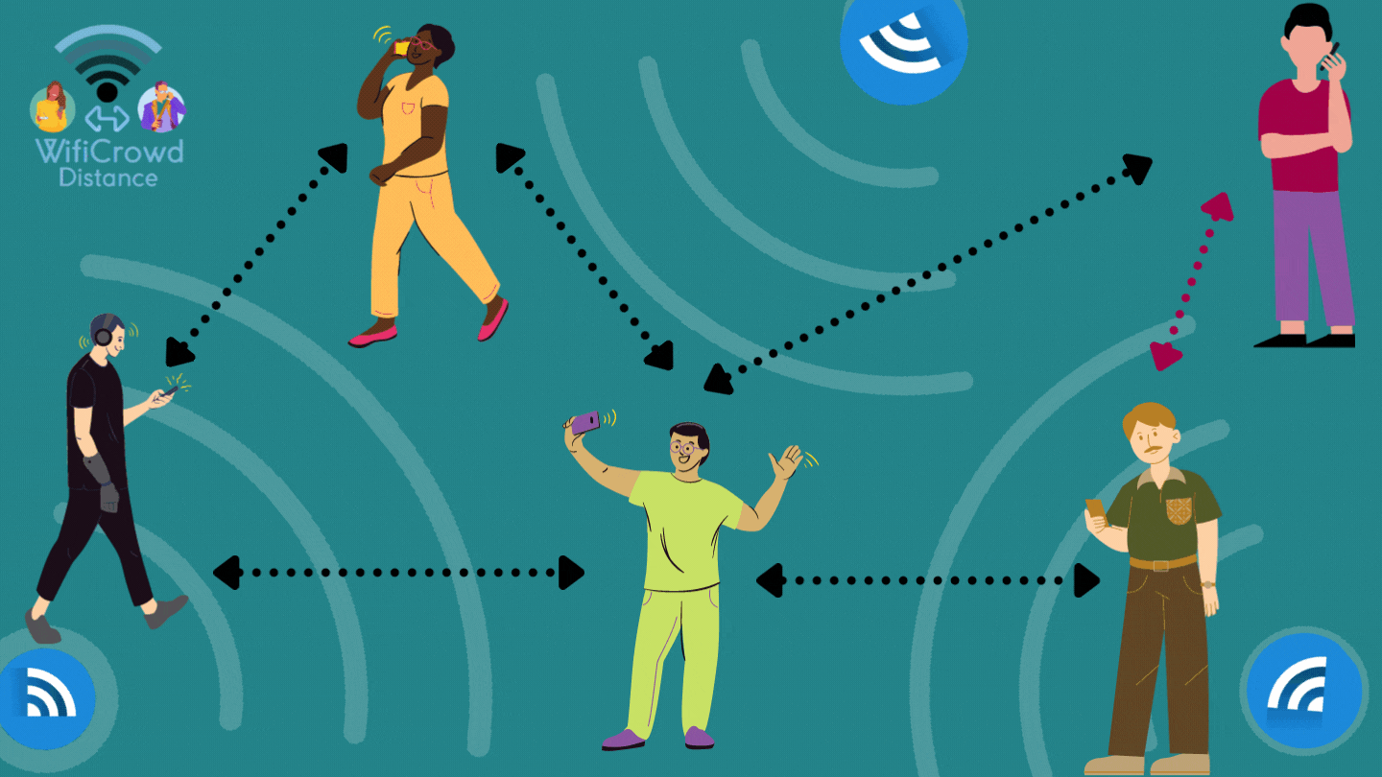

Slide 4
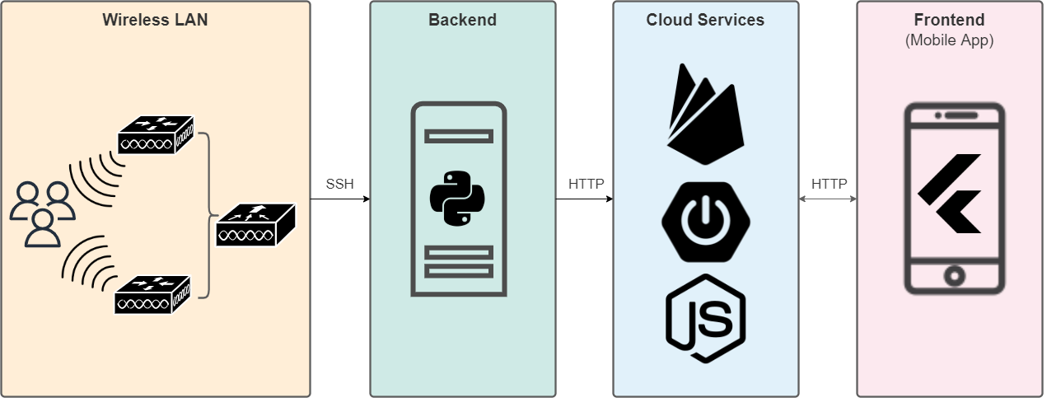
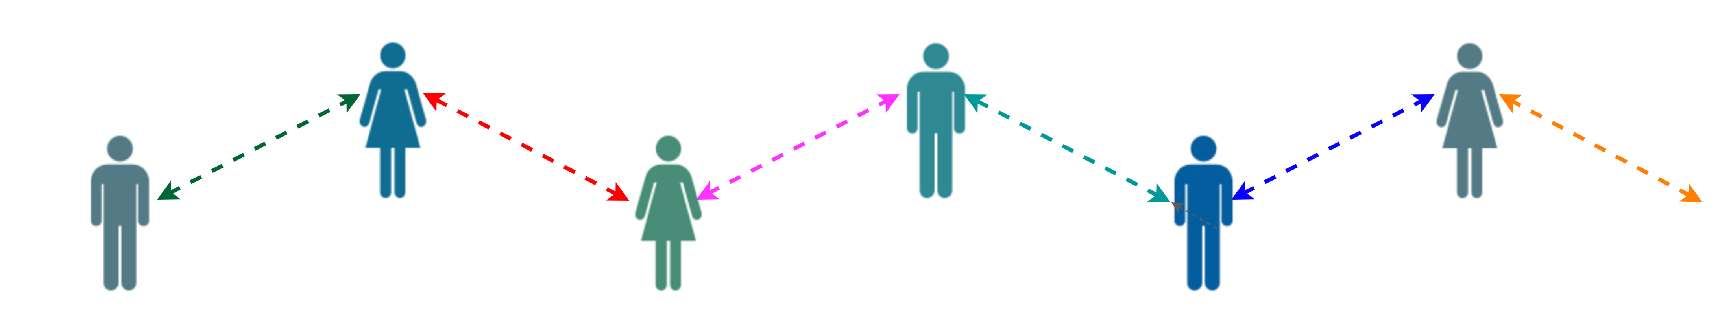

IMPLEMENTATION DIAGRAM

Slide 5
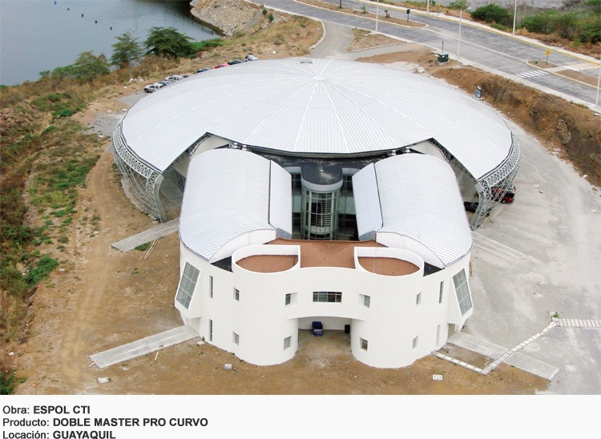
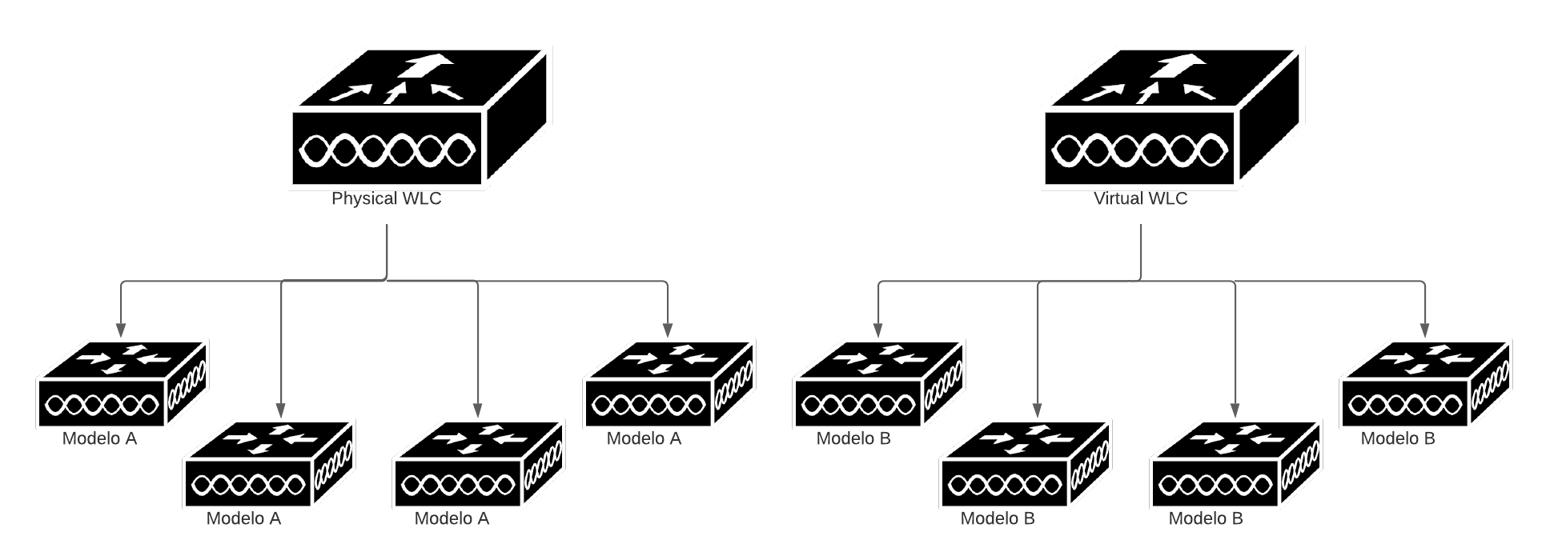
SCENARIO and Infrastructure
Accessed via SSH credentials with read permissions
Source: acesco.com.ec/linea-industrial/

Slide 6
Comands wlc
Show ap summary
Shows AP list with its respective name, model, MAC and number of connected clients.
Show client summary username
Shows the number of clients with their respective names, MAC, associated AP and connection status.
Show client detail MAC_CLIENTE
Shows a summary of all client information including username, associated AP name and MAC, WLAN SSID, RSSI received by associated AP and nearby APs.

Slide 7
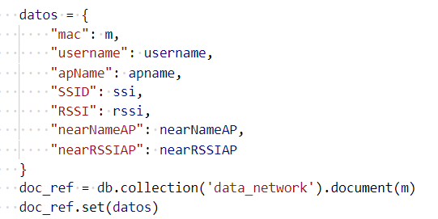
RESULTs SCRIPT - PYTHON
Datos JSON

Slide 8
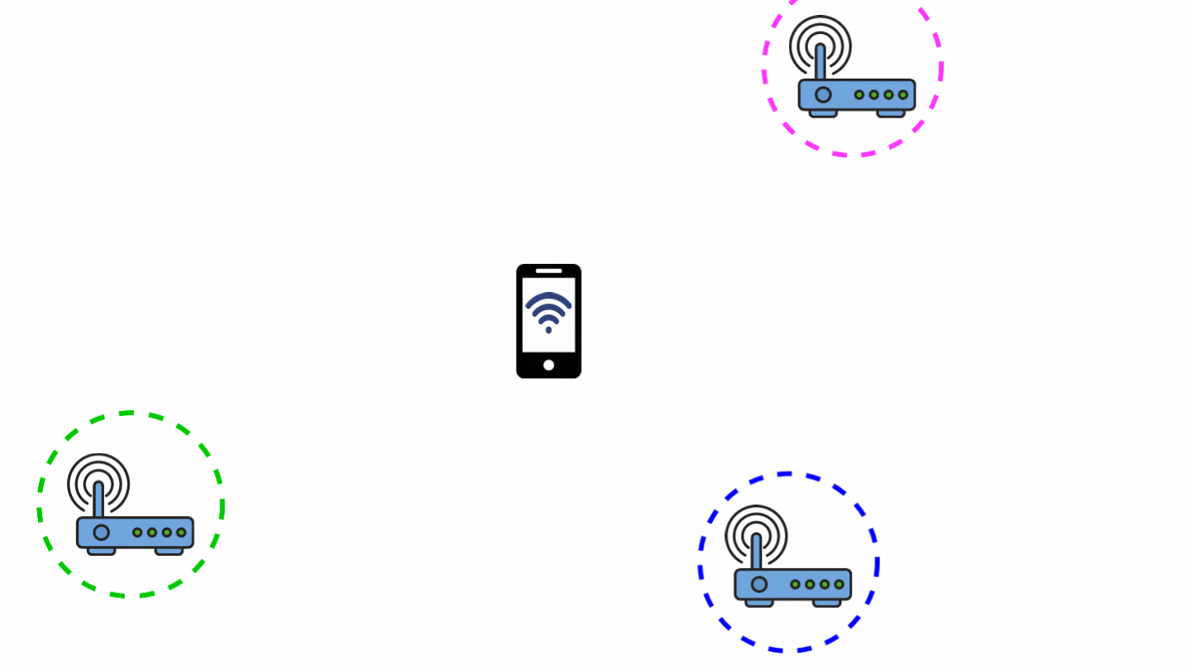
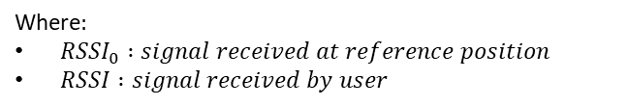
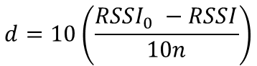

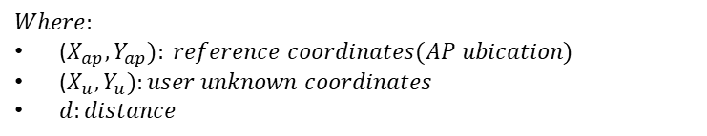
TrilateraTION
$$Least Squares$$
$$Path Loss$$
$${(X_{ap }−X_{u})}^{2}+{(Y_{ap}−Y_{u})}^{2}=d^{2}$$
$$d=10\left(\frac{{RSSI}_{0} −RSSI}{10n}\right)$$
$$Where:$$
($X_{ap},Y_{ap}): reference coordinates(AP ubication)$
($X_{u},Y_{u}):user unknown coordinates$
$d:distance$
Where$:$
${RSSI}_{0} :signal received at reference position$
$RSSI :signal received by user$

Slide 9
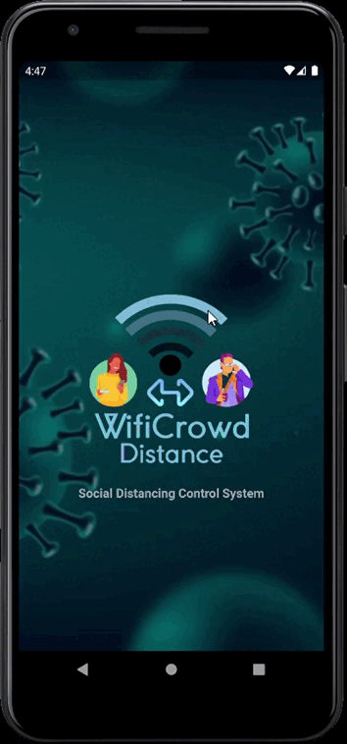
WIFICROWD DISTANCE

Slide 10
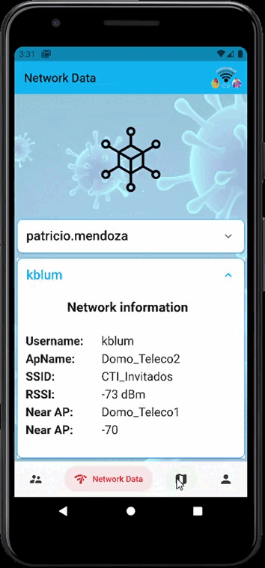
WIFICROWD DISTANCE

Slide 11
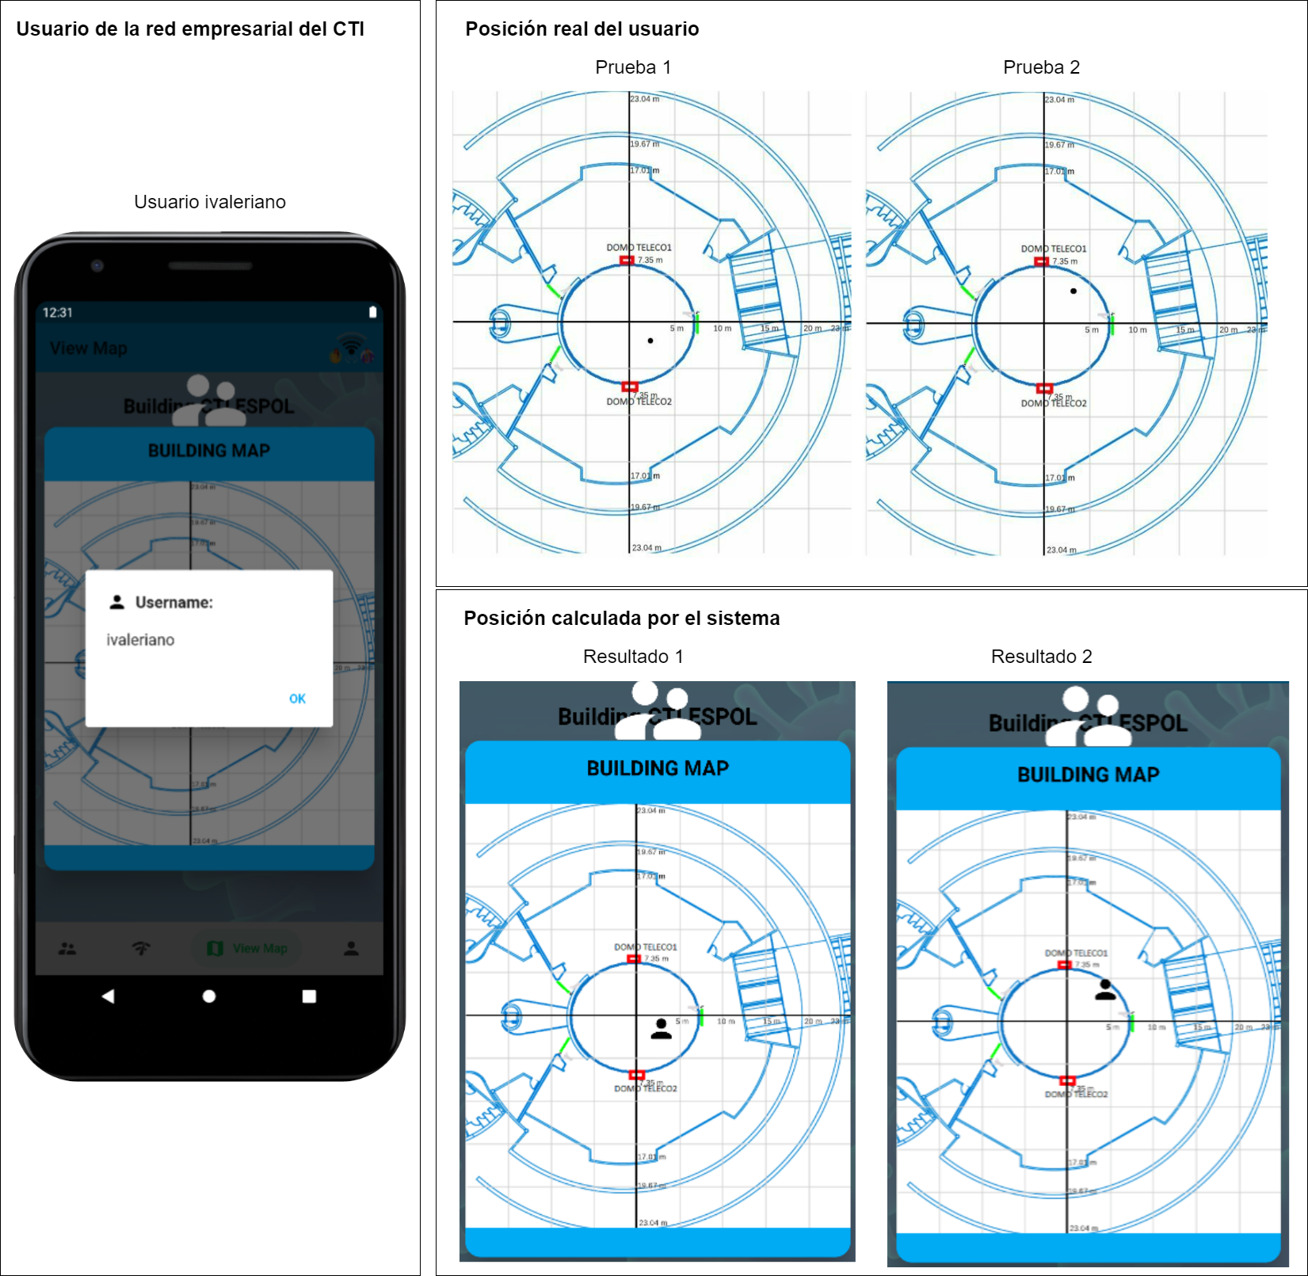
SCENARY TESTs

Slide 12
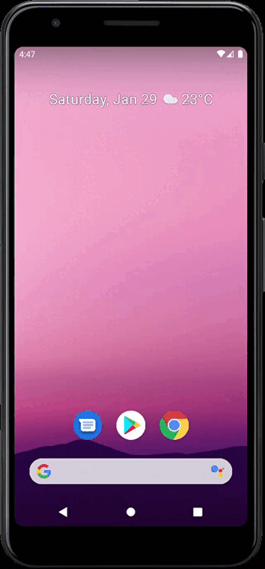
alert management

Slide 13

BUDGET
Monthly description | Cost
Existing Wi-Fi network infrastructure. | $0
Support and maintenance | $200
Cloud services on demand | $1.12
Total | $241.12

Slide 14

BENEFITS
It has an automated control of social distancing.
Reduces the chances of contagion.
Generates instant alerts when measures are breached.
Low implementation cost and little intrusive to the end customer.

Slide 15





CONTACT US
Kevin Steve Blum Luna
098 665 2994
kblum@espol.edu.ec
Marina Nicolle Toala Zurita
098 337 4536
mntoala@espol.edu.ec

